Slide 1



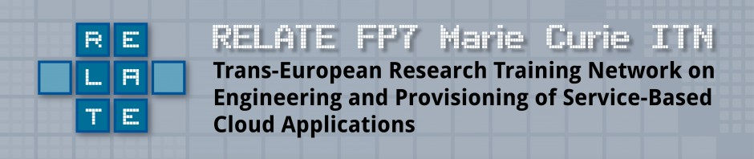
Variability Management in Domain-Specific Languages
David Méndez-Acuña
Benoît Combemale (Co-Advisor)
Benoît Baudry (Co-Advisor)
Doctoral Symposium
ACM/IEEE 17th International Conference on Model Driven Engineering Languages and Systems
Notes:
Good morning everyone. My name is David Méndez-Acuña. I am from Colombia and I am a first-year PhD student in the University of Rennes 1, in France. In particular, I conduct my research in the INRIA laboratory under the supervision of professors Benoît Combemale and Benoît Baudry. This research work is partially funded by an Marie Curie scholarship and it is developed in the context of the VaryMDE project that is a collaboration between the INRIA lab and Thales Research and Technology.

Slide 2

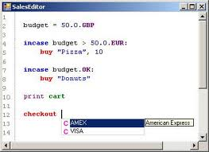
Research Context Domain-Specific Languages and Multi-Companies
DSLs
2
Notes:
The research context of this thesis is the universe of domain-specific languages and, in particular, the usage of this kind of languages in large companies where the business is focused on innovation technology. Some of those companies share the characteristic of being more multi-companies in the sense that there are several business interacting each other.

Slide 3

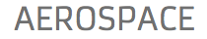
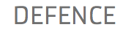

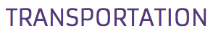
Research Context Domain-Specific Languages and Multi-Companies
DSLs
“From aerospace, space and defense to security and transportation, Thales helps its customers to create a safer world by giving them the tools they need to perform critical tasks.”
http://www.thalesgroup.com
3
Notes:
Thales is an example of this kind of companies where there are domains such as aerospace, defense, security, and transportation that co-exist.

Slide 4
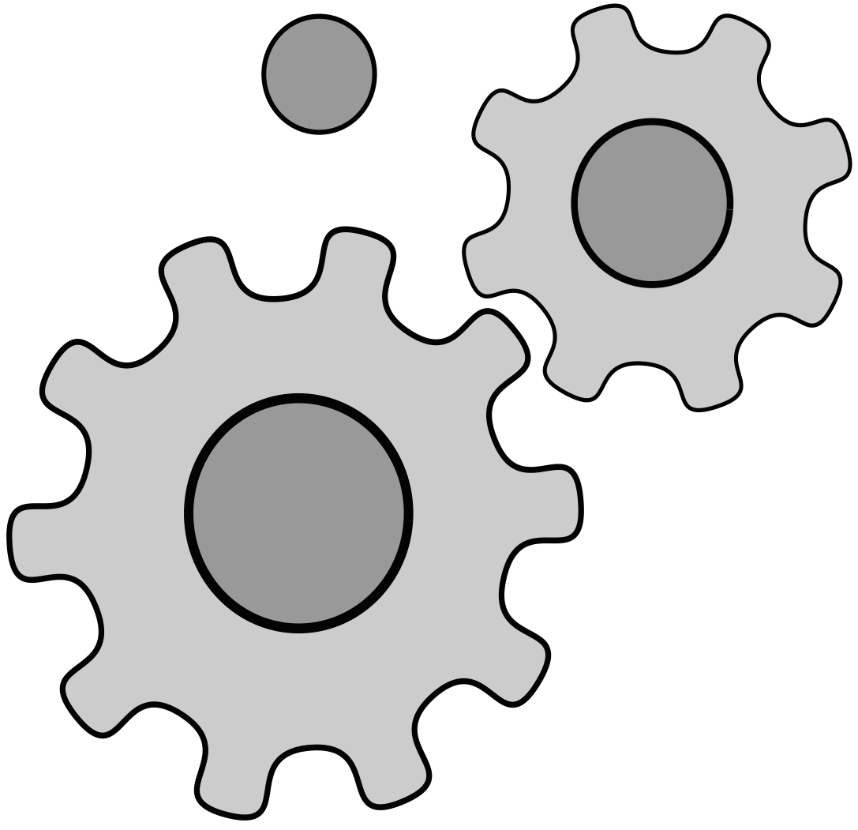
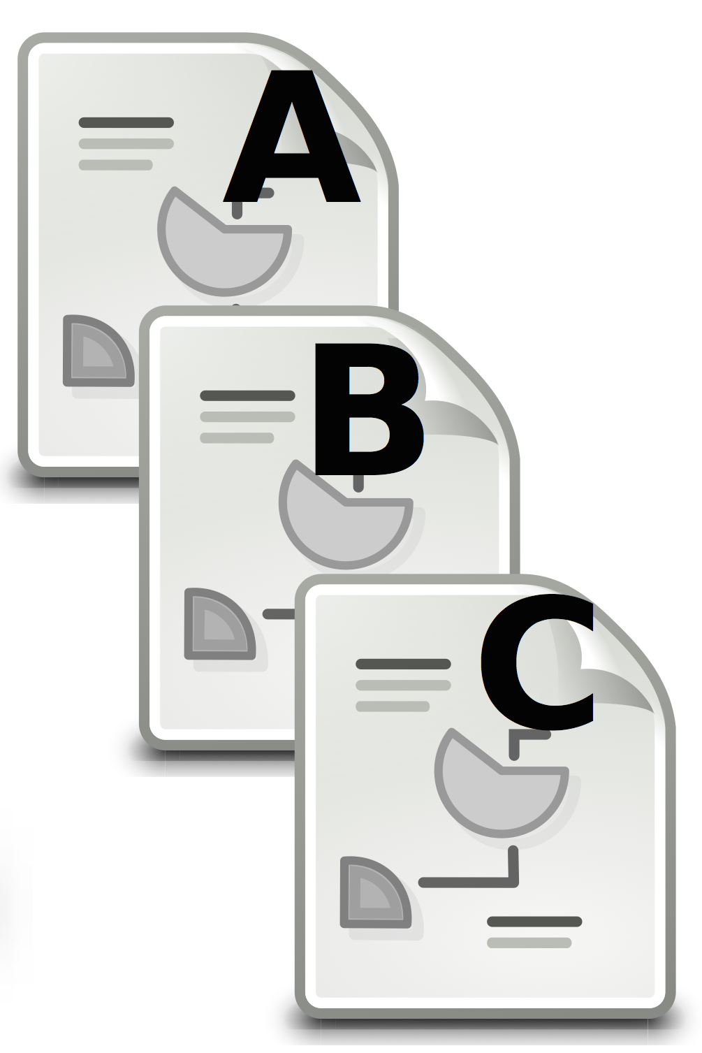
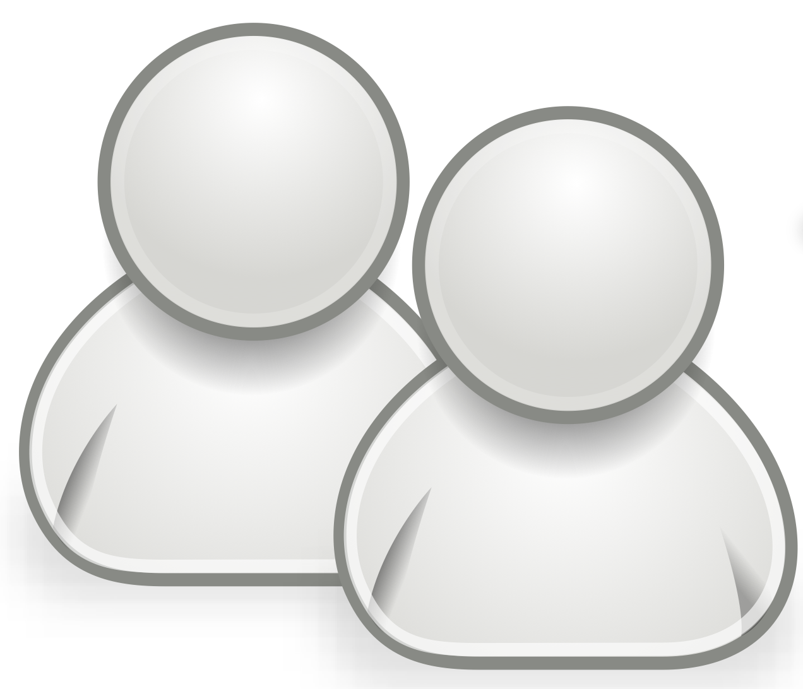
Research Context Observations [1]
DSL
1
Code generation
Domain Experts
DSL
2
Code generation
Domain Experts
Final System
DSL
3
Code generation
Domain Experts
… n
4
Notes:
In this context we have two observations. The first one is that the company uses more than one DSL. Each of them contributing to one small concern of the final system.

Slide 5
Research Context Observations [2]
DSL
Code generation
Domain Experts
DSL
Code generation
Domain Experts
Final System
DSL
Code generation
Domain Experts
Similar DSLs
[Commonalities + particularities]
= Families of Languages
5
Notes:
And the second one (that is the one we are interested on) is that, in several cases, several business units use similar DSLs. SIMILAR BUT NOT IDENTICAL since there are several syntactic and semantic differences. When that happens we say that we have a family of languages.

Slide 6
Research Context Family of Languages for Finite State Machines
Semantic and syntactic variation points in languages for FSM
UML state machines diagrams
Rhapsody
States and simple transitions (triggers, conditions, etc.)
Classical statecharts
Example: A family of languages for Finite State Machines
event[condition]
A
B
Academic example:
Crane, M., Dingel, J., UML vs. classical vs. Rhapsody statecharts: not all models are created equal. Software & Systems Modeling. Vol. 6 No. 4. Springer-Verlag 2007.
6
Notes:
To illustrate these observations I will introduce an academic example proposed by Crane et. al. in this paper. Although this is an academic example, it illustrates a problematic that actually occurs in the context of Thales.
We have three different formalisms for expressing finite state machines: UML state machine diagrams, Rhapsody, and Classical statecharts. The three of them share the basic state machine notions of states, simple transitions, triggers, and conditions. As a result, in the three languages we will be able to represent this small state machine.

Slide 7
Research Context Family of Languages for Finite State Machines
Semantic and syntactic variation points in languages for FSM
UML state machines diagrams
Rhapsody
Timed Transitions
Classical statecharts
Example: A family of languages for Finite State Machines
event[condition] : time(ms)
A
B
Academic example:
Crane, M., Dingel, J., UML vs. classical vs. Rhapsody statecharts: not all models are created equal. Software & Systems Modeling. Vol. 6 No. 4. Springer-Verlag 2007.
7
Notes:
However, the situation is different with the notion of Timed Transitions (transitions whose execution may take some time). While UML state diagrams and Rhapsody support this concept, it is not supported by classical statecharts where the hypothesis is that transitions take zero time for being executed.

Slide 8


Problem Statement Isolated Software Development Processes
UML state machines diagrams
Classical statecharts
Rhapsody
10
Notes:
The main problem when this kind of families of DSLs (at least in the context of Thales, but the same problem occurs in other companies) is that each formalism is usually built and maintained separately. Each language has an independent life cycle and, in many cases, even the development team is different. As a result, we have replicated effort in a common problem that (1) is not easy to solve because the construction of a DSL is not an easy task, and (2) that is expensive to maintain.

Slide 9

Proposed Approach From Families of Languages to Language Product Lines
Example: A family of languages for Finite State Machines
Software Languages are Software too!
Jean-Marie Favre, Dragan Gasevic, Ralf Lmmel, and Ekaterina Pek. Empirical Language Analysis in Software Linguistics. In Software Language Engineering. Springer. 2011
Software Engineering Techniques … Software Product Lines Engineering
Feature A
Feature B
Feature B
F. D
F. D
F. D
F. D
F. D
F. D
Méndez-Acuña’s
PhD
Family of Languages
Language Product Line
Steffen Zschaler, Pablo Sánchez, Joo Santos, Mauricio Alférez, Awais Rashid, Lidia Fuentes, Ana Moreira,
Joo Arajo, and Uir Kulesza. VML* A Family of Languages for Variability Management in Software Product Lines. In Software Language Engineering. Springer. 2010.
11
Notes:
To solve this problem we base our work in an observation made by Jean Marie Favre et. al in this paper. Software Languages are Software too. And consequently, we have all the Software Engineering Techniques for optimizing the software development processes of Domain-Specific Languages. In particular, we have the ideas of Software Product Lines Engineering, and then, we can conceive the notion of Languages Product Lines (a term used in this paper that perfectly illustrates the application of SPLE in SLE).
The main purpose of this thesis to contribute to the definition of a methodology and the tools that support the construction of this kind of approaches.

Slide 10
Research Challenges From Families of Languages to Language Product Lines
Objective: REUSE
Family of DSLs
12
Notes:
In that context, our first contribution is the definition of the challenges that should be addressed towards the construction of Languages Product Lines for a Family of DSLs. For us, this definition of challenges is a really important definition since it is the way we find to decompose the problem in several sub-problems that we can address one by one.

Slide 11
Research Challenges From Families of Languages to Language Product Lines
Language Units
Modular Languages Design
(1)
Family of DSLs
13
Notes:
The first thing we realized is that to increase (or better introduce) the reuse during the development of families of DSLs we need to separate the commonalities from the particularities. Then, the commonalities can be developed once and reused by the DSLs that require it. It is important to mention that this challenge should be addressed at both the methodological and the technological level. From the methodological level there are questions such as “what is the correct level of granularity at which the language family should be decomposed?”. At the technological level, we need to solve the problem of specifying the language in a modularized way.

Slide 12
Research Challenges From Families of Languages to Language Product Lines
Feature A
Multi-dimensional & staged
variability modeling
(2)
Feature B
Feature B
F. D
F. D
F. D
F. D
F. D
F. D
Variability Models &
Configuration
Language Units
Modular Languages Design
(1)
Family of DSLs
14
Notes:
After decomposing the language in several language units, we need to represent in some artifact that variation points supported by the family. This is important for two reasons. The first one is that modeling the variability is a way of formalizing the variation points of the family so at the end those variation points are well documented and there are a set of rules that precisely indicate the way in which the decision made for each variation point can be combined. The second reason is that this artifact can offer the service of configuring a member of the family i.e., to express the decisions made for each variation point for a particular DSL.

Slide 13
Research Challenges From Families of Languages to Language Product Lines
Feature A
Multi-dimensional & staged
variability modeling
(2)
Feature B
Feature B
F. D
F. D
F. D
F. D
F. D
F. D
Variability Models &
Configuration
Language Units
Modular Languages Design
(1)
Language Units
Composition
(3)
Configured
DSL
Family of DSLs
15
Notes:
The third challenge is the composition of the language units after the configuration of a particular DSL. In other words, after selecting those variations we decided to include for a particular product, we need to assembly the configured DSL.

Slide 14
Related Work (1) Modular Languages Design & (2) Composition
Concrete
Syntax
Abstract
Syntax
Semantics
Grump,
Modularized Xtext
MontiCore,
LISA, Neverlang
Attribute Grammars
16
Notes:
Then, we have a second form of modularization that is more horizontal in the sense that refers to the actual decomposition of a language in several interdependent units. In that context, approaches differ depending on if they deal with metamodel-based DSLs or grammar-based ones. Approaches also differ in their scope. Some of them are focused on syntax, some other ones in semantics. We have also to take into account the type of syntax they use and the paradigm for semantics specification (operational, translational, …)
Currently we are working on a study for summarizing what is the state of the art of the current approaches in this context.

Slide 15
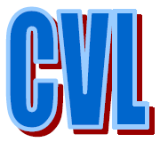


Related Work
(3) Multi-dimensional & staged variability modeling
General variability modeling
Marko Rosenmüller, Norbert Siegmund, Thomas Thüm, and Gunter Saake. 2011. Multi-dimensional variability modeling. In Proceedings of the 5th Workshop on Variability Modeling of Software-Intensive Systems (VaMoS '11)
Languages-specific variability modeling
María Victoria Cengarle, Hans Grönniger, Bernhard Rumpe. 2009. Variability within Modeling Language Definitions. In Proc of International Conference in Model Driven Engineering Languages and Systems. Models.
Feature A
Feature B
Feature B
F. D
F. D
F. D
F. D
F. D
F. D
17
Notes:
In terms of the variability modeling for families of DSLs, we have two main types of approaches in the state of the art. The first one corresponds to the approaches for modeling variability in the general case of Software Product Lines. In that context we can find a variety of languages such as CVL, Familiar, FAMA, just to mention a few. However, I would like to highlight the work of … et al that addresses the problem of multi-dimensional variability that is relevant in the case of SLE. SHOW THIS PAPER.
On the other hand, we have the approach presented in this paper that is focused on modeling the existing variability in the case of software languages. It presents some basic definitions that formalize the dimensions of the variability in software languages.

Slide 16
Related Work
Identified Coopetitors
MontiCore + Variability Modeling. Cengarle, et al.
María Victoria Cengarle, Hans Grönniger, Bernhard Rumpe. 2009. Variability within Modeling Language Definitions. In Proc of International Conference in Model Driven Engineering Languages and Systems. Models.
NeverLang + Variability Modeling: Vaccchi et. Al.
Edoardo Vacchi, Walter Cazzola, Suresh Pillay, Benoît Combemale. 2013. Variability Support in Domain-Specific Language Development. In Proc of Software Language Engineering. Springer.
Families of Domain-Specific Languages: Liebig et. al.
Jörg Liebig, Rolf Daniel, and Sven Apel. 2013. Feature-oriented language families: a case study. In Proceedings of the Seventh International Workshop on Variability Modelling of Software-intensive Systems (VaMoS '13)
Families of Domain-Specific Languages + Roles: Wende et. al.
Christian Wende, Nils Thieme, Steffen Zschaler. A Role-Based Approach towards Modular Language Engineering. In Proc. Of Software Language Engineering. 2010
18
Notes:
At this point we can summarize or coopetitors. We call coopetitors to those that are working on the problem of engineering Languages Product Lines from Families of Languages so they have to tackle (in somehow) all the challenges we just mentioned.
In particular, we have identified… … …

Slide 17
Limitations & Contributions From Families of DSLs to Language Product Lines
Direct dependencies between artifacts
Language
Unit A
Language
Unit B
Language
Unit A
Language
Unit B
Language
Unit A
Language
Unit B
Language Units
Modular Languages Design
(1)
Configured
DSL
Family of DSLs
19
Notes:
Let us now present the limitations we have found in the state of the art and our contributions in terms of solutions for overcome these limitations. The first one can be found in the first challenge: Modular Languages Design and is related with the way in which dependencies are expressed between language units. In the general case, the dependencies are expressed as direct references among the language units

Slide 18
Limitations & Contributions From Families of DSLs to Language Product Lines
Direct dependencies between artifacts
Language
Unit A
Language
Unit B
Language
Unit A
Language
Unit B
Language
Unit A
Language
Unit B
?
Language
Unit B
Language
Unit B
Language
Unit B’
Language Units
Modular Languages Design
(1)
Configured
DSL
Family of DSLs
20
Notes:
That has two problems, the first one is that the idea of substitutability is not correctly supported. That means that change the implementation of certain language unit is not that simple since there accomplishment is to strong and, in any case, we need to modify the requiring language unit.

Slide 19
Limitations & Contributions From Families of DSLs to Language Product Lines
Direct dependencies between artifacts
?
Language
Unit A
Language
Unit B
Language
Unit A
Language
Unit B
Language
Unit A
Language
Unit B
Language Units
Modular Languages Design
(1)
Configured
DSL
Family of DSLs
21
Notes:
On the other hand, the notion of “contract” is not defined so it is not possible to make static verification of compatibility. As a result, we only know that two language units are not compatible when the composition fails.

Slide 20
Limitations & Contributions From Families of DSLs to Language Product Lines
Direct dependencies between artifacts
Language
Unit A
Language
Unit B
Language
Unit A
Language
Unit B
Language
Unit A
Language
Unit B
Language Units
Christian Wende, Nils Thieme, Steffen Zschaler. A Role-Based Approach towards Modular Language Engineering. In Proc. Of Software Language Engineering. 2010
Modular Languages Design
(1)
Configured
DSL
Family of DSLs
22
Notes:
These limitations are the motivations of the work presented in this paper. PUT THE PAPER! The authors introduce the idea of interfaces by using the concept of role. This is a huge contribution to the state of the art and it enables the separation of features. However, because the definition of the interfaces include the syntactical and the semantical part at the same time, support concerns is not possible.

Slide 21
Limitations & Contributions From Families of DSLs to Language Product Lines
Language Interfaces
Language
Unit A
Language
Unit B
Language
Unit A
Language
Unit B
Language
Unit A
Language
Unit B
Required vs. Provided interfaces
Language Units
Modular Languages Design
(1)
Configured
DSL
Family of DSLs
23
Notes:
The purpose is to define the notion of languages interfaces that supports not only the separation of features but also the separation of concerns. We are working in the definition on what are the needs of the definition of these interfaces and what are the correct formalisms for expressing them.

Slide 22
Limitations & Contributions From Families of DSLs to Language Product Lines
Feature A
Multi-dimensional & staged
variability modeling
(2)
Feature B
Feature B
F. D
F. D
F. D
F. D
F. D
F. D
Variability Models &
Configuration
Language Units
Family
Concrete S.
Abstract S.
Semantics
Feature A
Feature B
Feature A
Feature B
Feature A
Feature B
F. D
F. D
F. D
F. D
F. D
F. D
F. D
F. D
F. D
F. D
F. D
F. D
F. D
F. D
F. D
F. D
F. D
F. D
Dependences?
Dependences?
24
Notes:
Although current approaches use variability models for expressing the variability in a Language Product Line, the notion of multi-dimensional and staged variability is not well supported. There is not a clear definitions about what are the restrictions that emerge from the multi-dimensional nature of software languages. As a result, the user may select incorrect configurations that, for example, include the definition of a the semantics for an inexistent segment of abstract syntax.

Slide 23
Limitations & Contributions From Families of DSLs to Language Product Lines
Feature A
Multi-dimensional & staged
variability modeling
(2)
Feature B
Feature B
F. D
F. D
F. D
F. D
F. D
F. D
Variability Models &
Configuration
Language Units
Formalization!
Family
Concrete S.
Abstract S.
Semantics
Feature A
Feature B
Feature A
Feature B
Feature A
Feature B
F. D
F. D
F. D
F. D
F. D
F. D
F. D
F. D
F. D
F. D
F. D
F. D
F. D
F. D
F. D
F. D
F. D
F. D
Implies
Implies
25
Notes:
Here our contribution will be focused on the formalization of the implies relationship for the particular case of variability modeling in software languages. It is also important to include support for dealing with the staged nature of the configuration. Abstract syntax first and then the corresponding feature models for concrete syntax and semantics. We plan to use CVL as a tool.

Slide 24
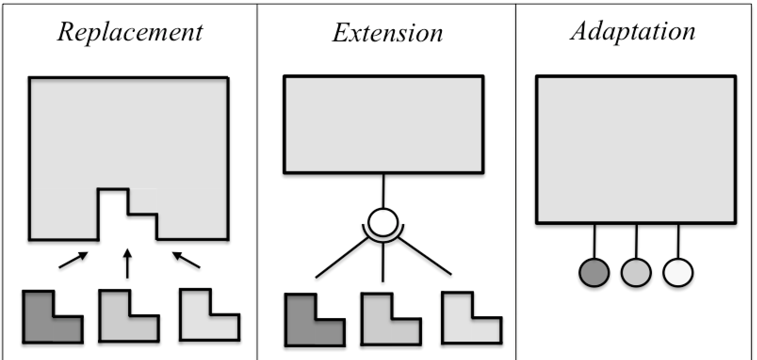
Limitations & Contributions From Families of DSLs to Language Product Lines
Language Composition Strategies &
Operators
Feature A
Feature B
Feature B
F. D
F. D
F. D
F. D
F. D
F. D
Variability Models &
Configuration
Language Units
Composition
(3)
Configured
DSL
Family of DSLs
26
Notes:
The first insight we have in this point is the definition of the composition requirements of software architectures documented in this book. PUT THE REFERENCE. We realized that, in fact, this topology also applies in the context of software languages variabiity. Currently, we are defining those operators. We already have a first prototype.

Slide 25
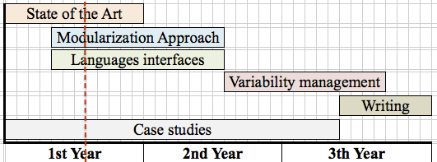
Current status and planned time-line
27

Slide 26
Open Questions
Formal definition of the concept of “FAMILY OF LANGUAGES”
Family of DSLs
Family of DSLs?
28
Notes:
Our definition of « families of languages » is currently: a set of languages that share some commonalities and that are distinguished each other by some particularities. According to that definitionboth cases in this slides are families of DSLs… but… the one at the right can be actually considered as a family?

Slide 27
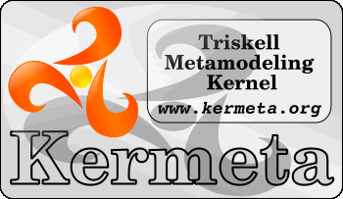


Open Questions
How to achieve interoperability between language units?
29

